Slide 1

TOLL ROADS in selected u.s. metropolitan areas Extract-transform-load project
Thomas Creegan
Andre Ebanks
Sumita Jain
December 14, 2019

Slide 2
PROJECT SCOPE
Purpose: To illustrate the principles of Extract, Transform, Load (ETL)
Scope: Investigate historical costs and congestion of toll roads in the US
Extract latest available toll road data from the Federal Highway Administration and the Bureau of Transportation Statistics
Transform data by:
Cleaning – prepare CSV files to properly load in Pandas
Filtering – selecting relevant column
Aggregating – combine data from multiple year
Develop a database that will allow users to compare two years of data to see how metrics such as cost per mile, number of miles of toll roads, population size, and Road Congestion Index relate

Slide 3
PROJECT SCOPE
Research data sources
Extract
Transform
Data Source 1 – Federal Highway Administration -- extract was a readily available csv file
Identified disparate data sources that would need to be combined to answer the questions
Steps to clean, normalize, etc.
1
2
3
4
5
6
7
Define project scope
Develop db schema
Extract (continued)
Load
Conceived of a data problem that would require multiple data sources
Determined data elements required for a useful db
Identified primary keys
Data Source 2 – Bureau of Transportation Statistics -- extract was a readily available csv file
Developed Postgres db with 2 tables

Slide 4
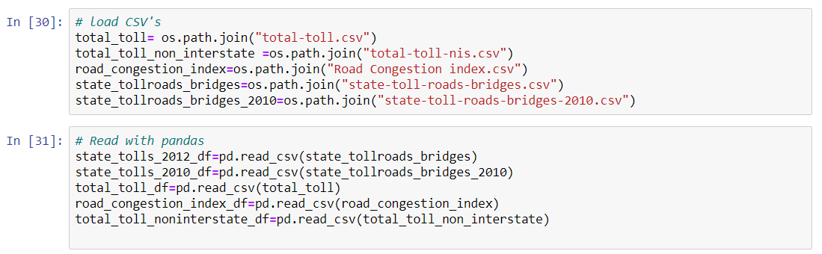
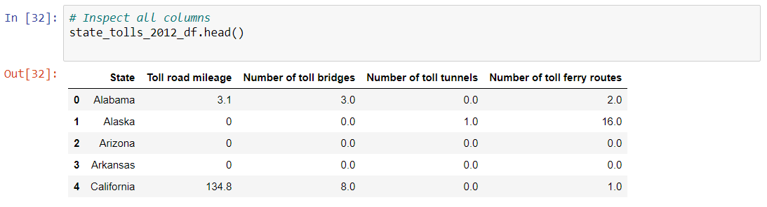
Extract

Slide 5
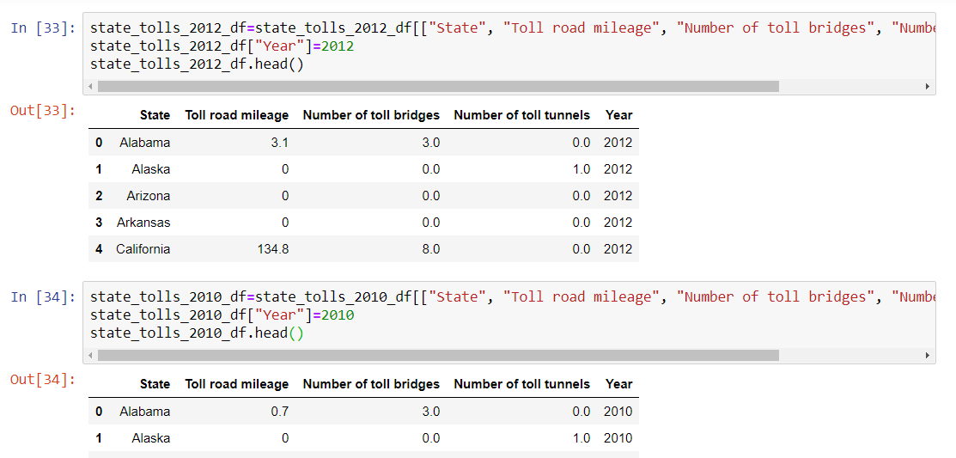
extract

Slide 6
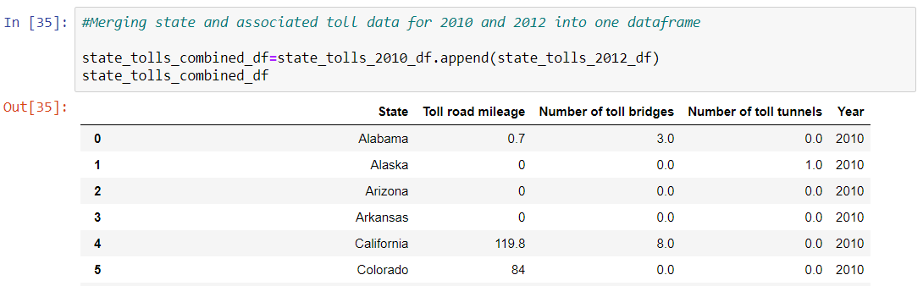
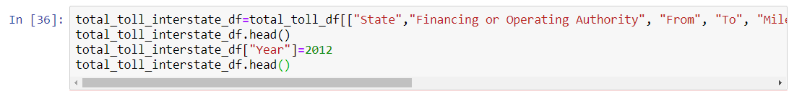
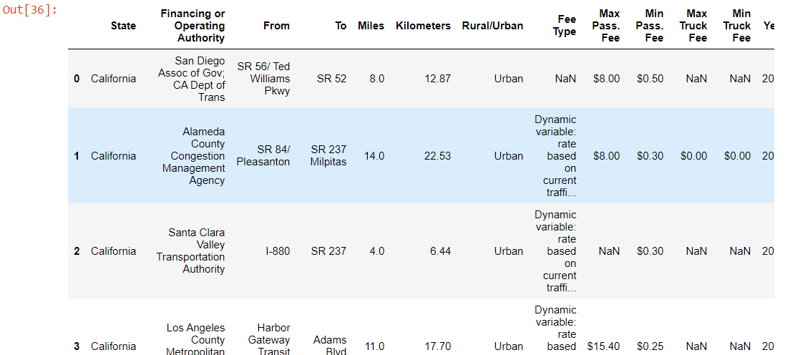
TRANSFORM

Slide 7
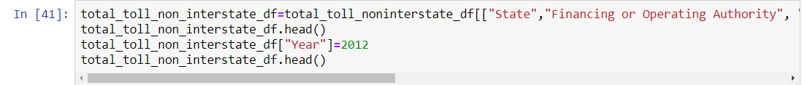
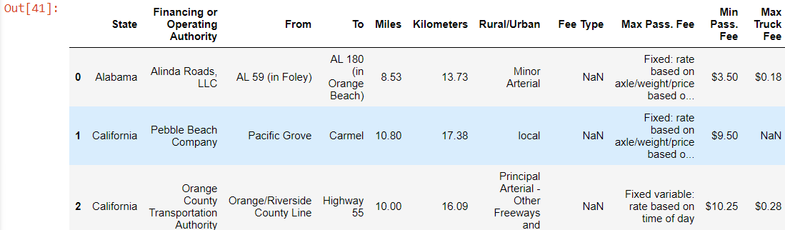
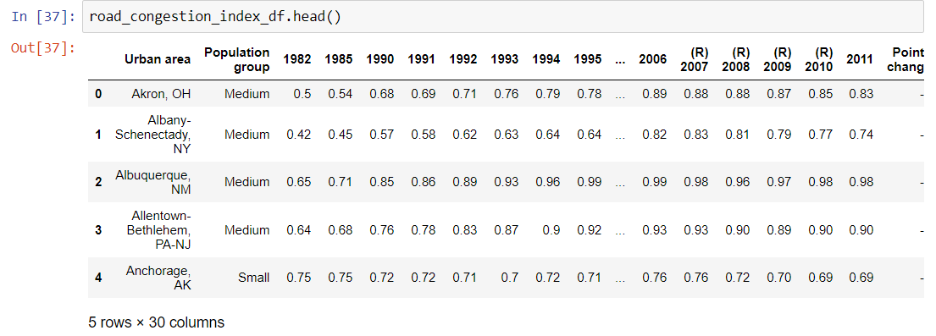
TRANSFORM

Slide 8
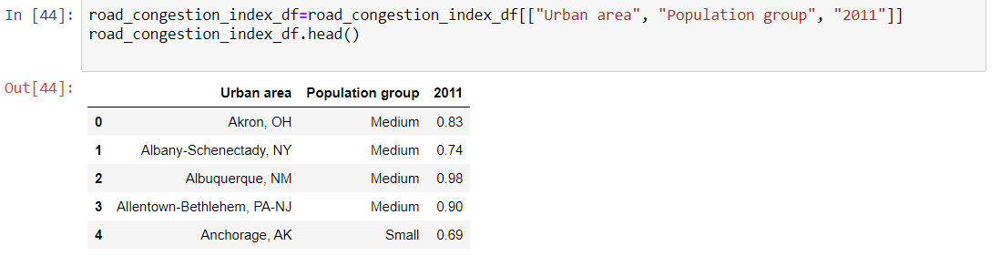
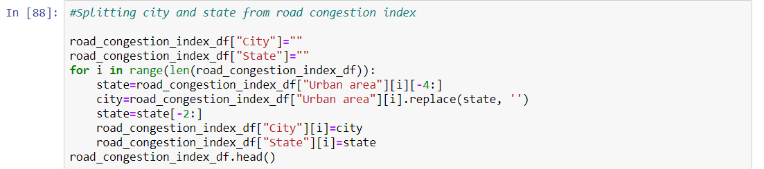
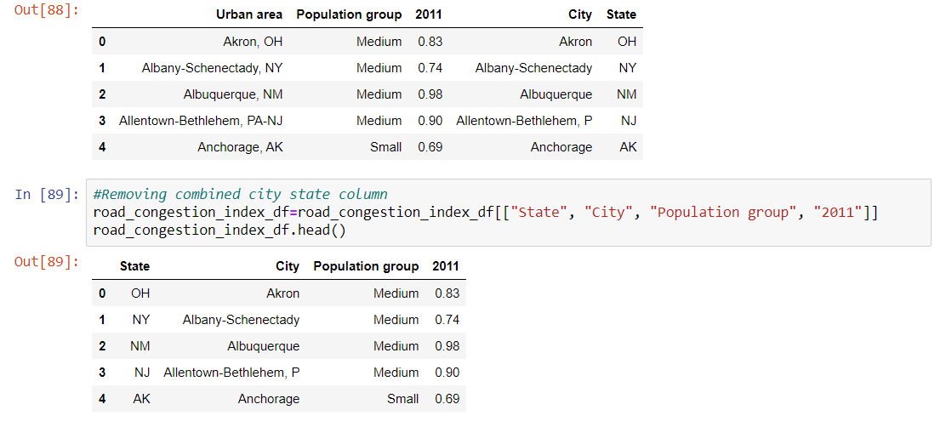
TRANSFORM

Slide 9
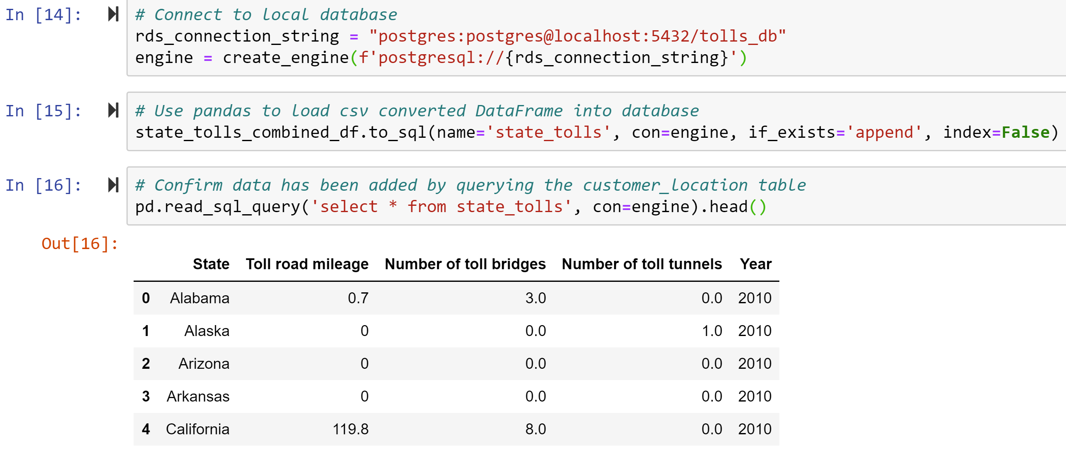
LOAD

Slide 10
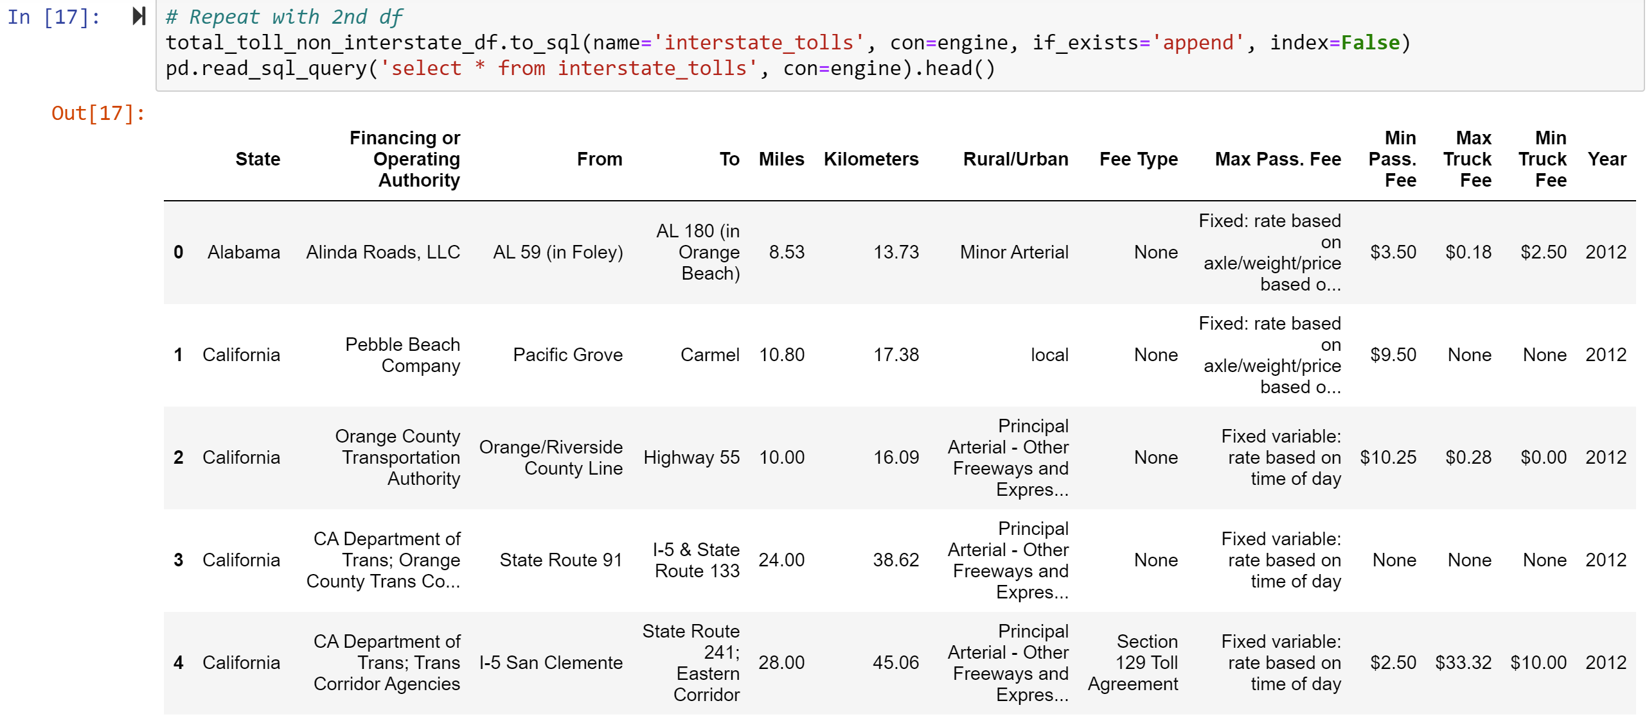
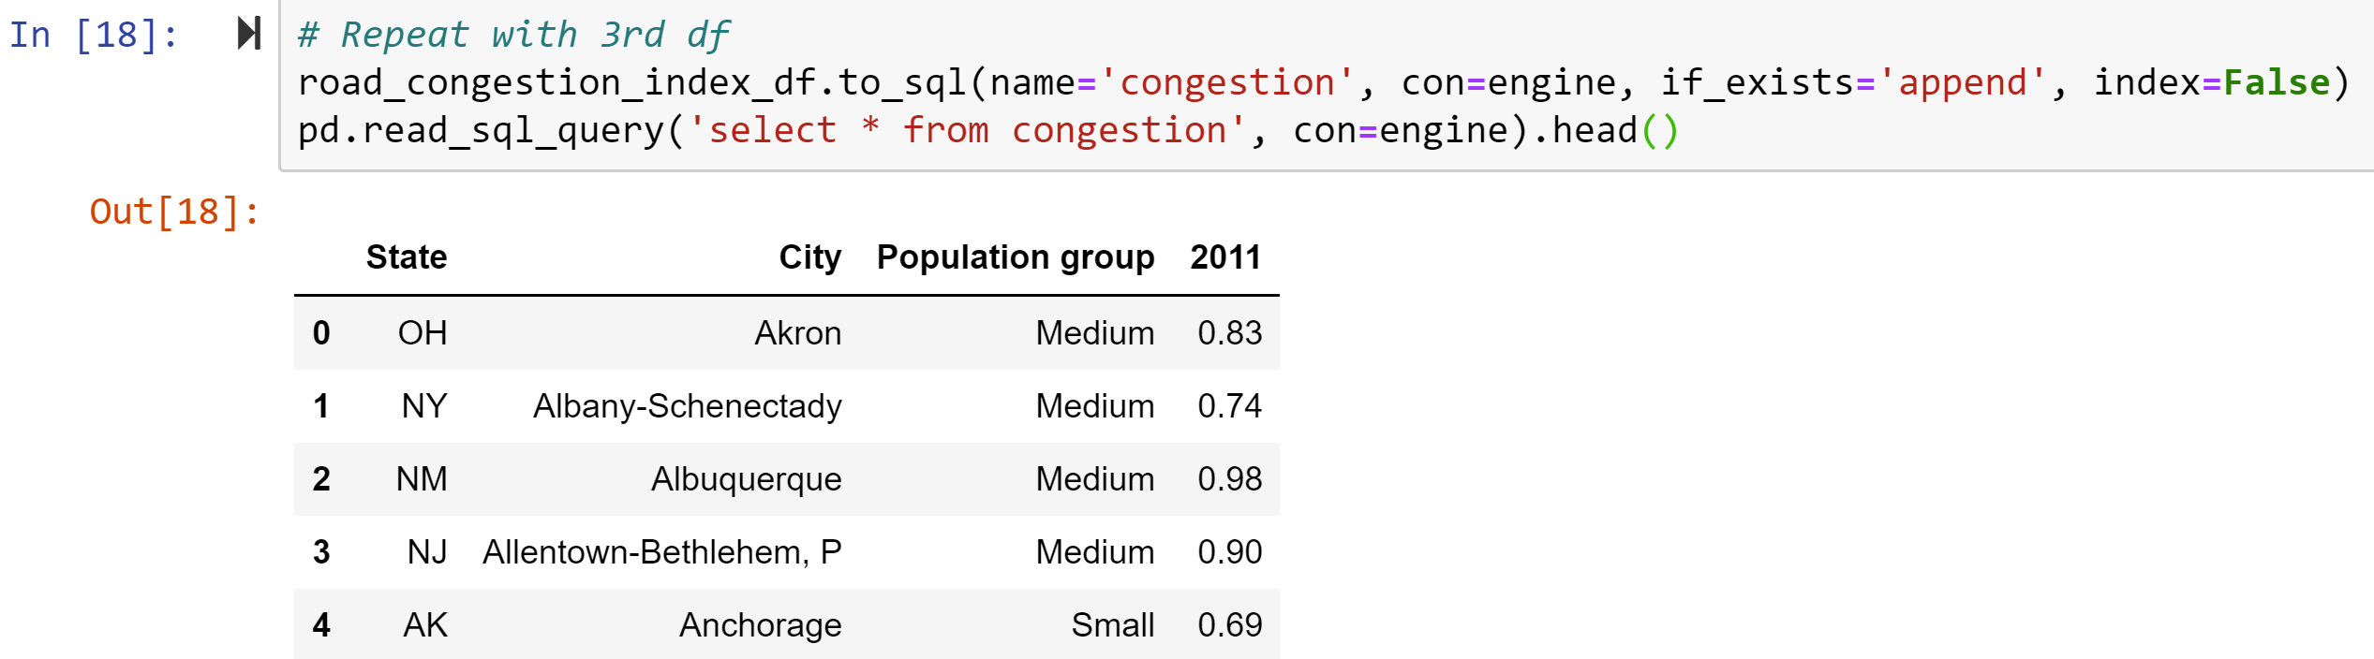
LOAD

Slide 11
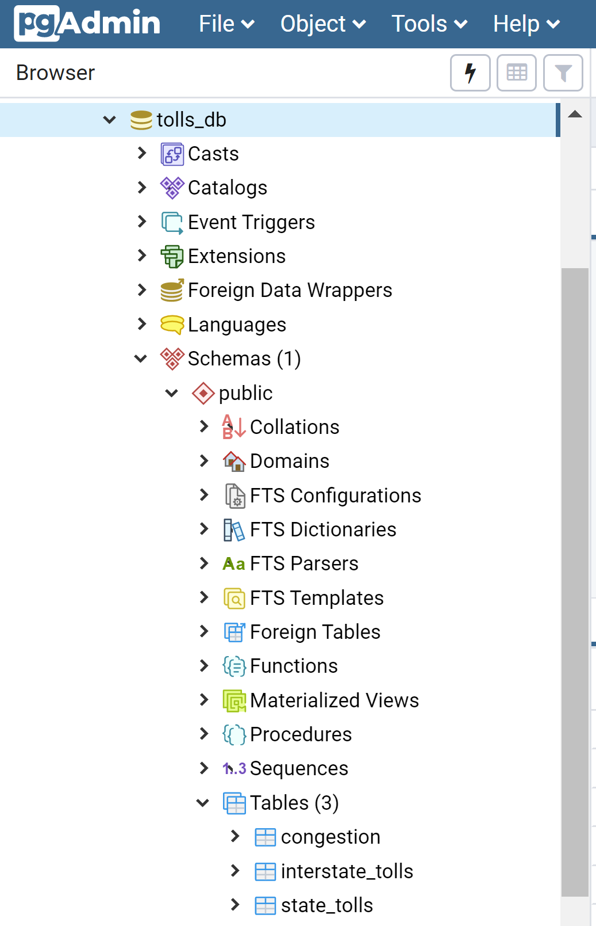
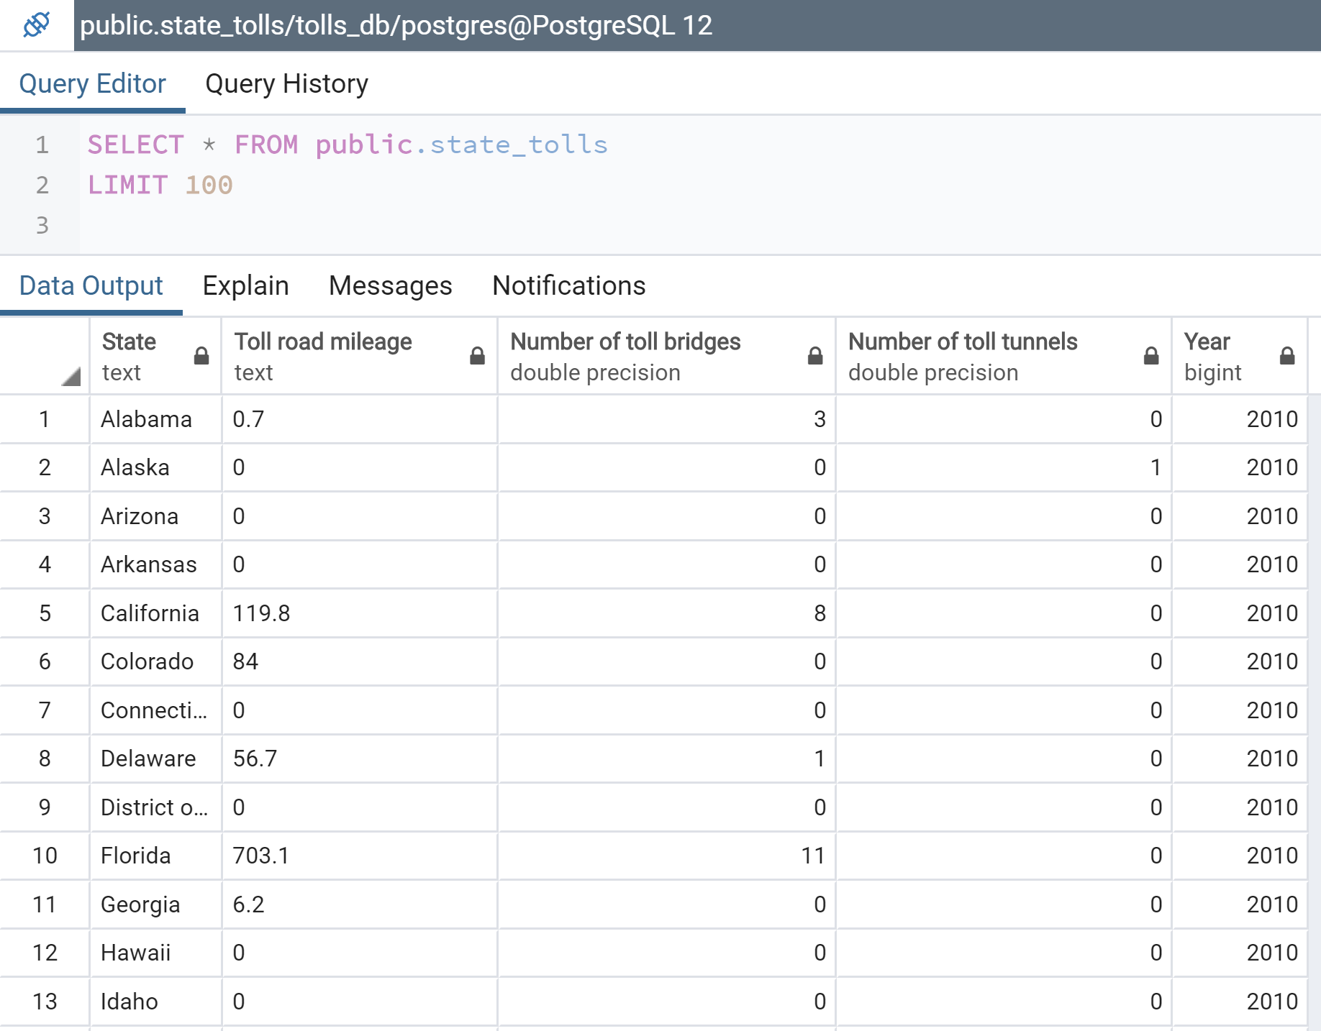
Load

Slide 12
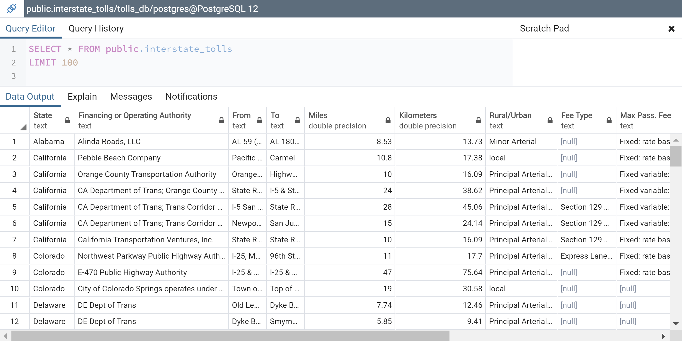
Load

Slide 13
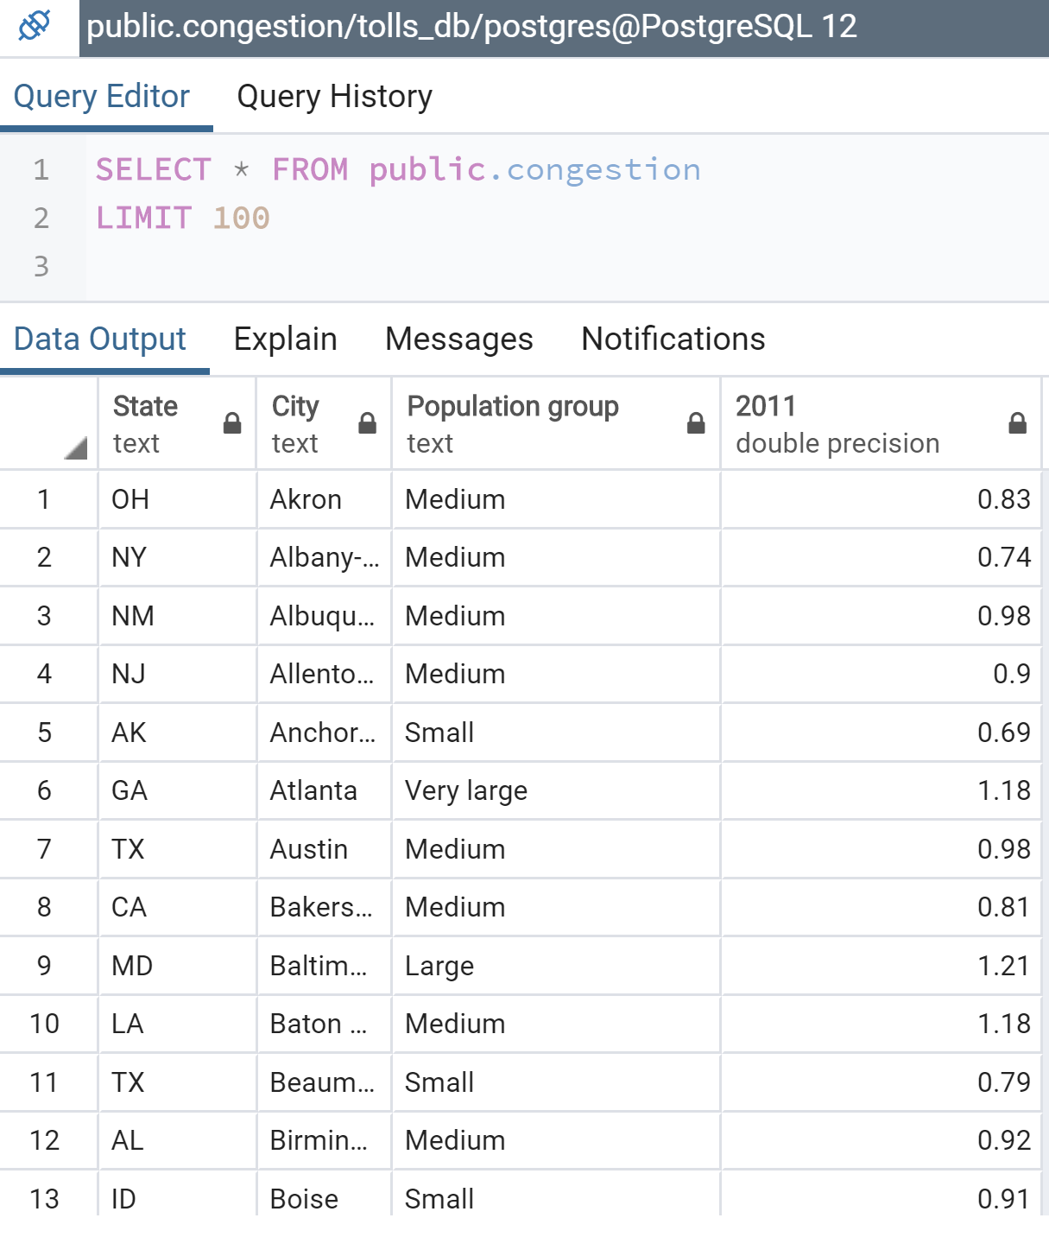
Load

Slide 14
Load

Slide 15
KEY takeaways
There are many different tolling mechanisms (for example, congestion vs. fixed pricing)
As expected, even eight years ago, the Road Congestion Index is higher in urban areas, and in many instances is one of the motivating factors for the implementation of tolls roads
A more robust analysis was thwarted by the absence of current data on the elements examined. While a toll road API was considered, the format of data was totally incompatible with the elements of our database. As such, it would be highly unlikely that a cohesive narrative could be obtained if this data was included with our existing data.

